Slide 1

A computational resource-friendly prediction system for health condition
Group 9: Wenjun Huang, Ziyu Wang, Yang Liu

Slide 2
Introduction
Management of in hospitalized patients has a significant bearing on outcomes, in terms of both morbidity and mortality. Therefore, it is desirable to build a model for the assessments of diabetes and advice for future care.
However, the explosively increasing amount of data introduces a challenge to the model training, i.e. the insufficient computational resources in the local machine.
We propose a distributed recommendation system that trains the model using a few computation-limited machines and generates personalized advice by using some desensitized data.
Notes:
Our motivation is that 1

Slide 3
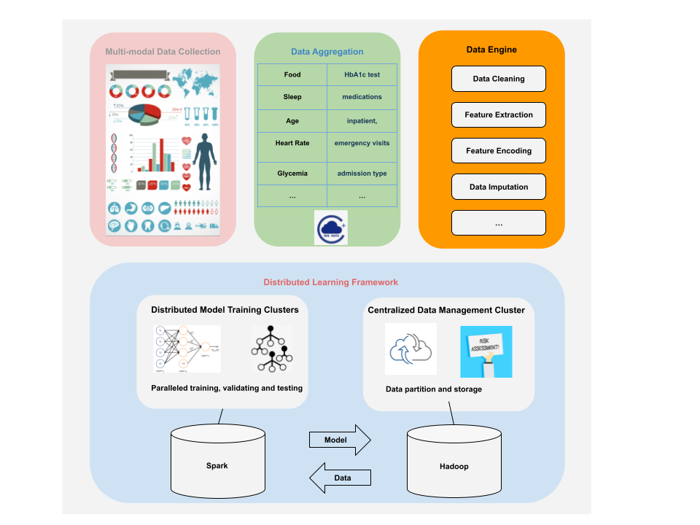
System Architecture
Notes:
Four parts, multi-modal data, including the medical care data from the hospital, the medication record, age, gender of the patient and etc

Slide 4
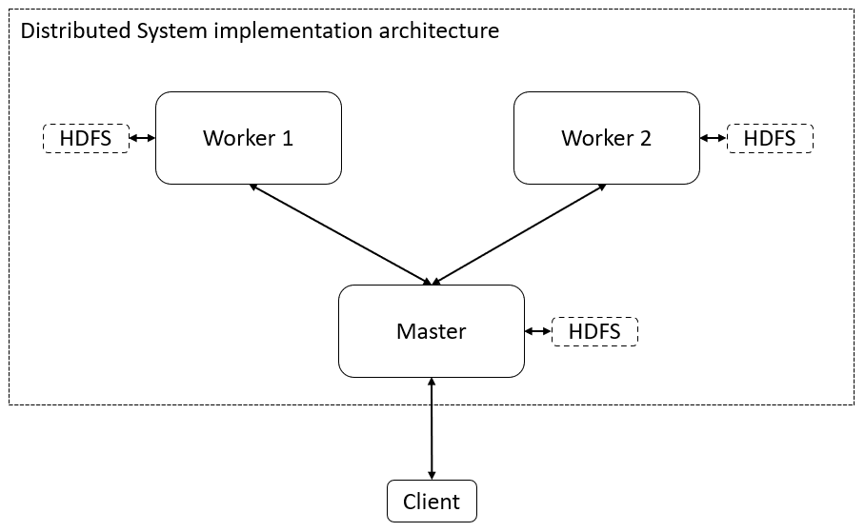
•Master: Data partitioning, model aggregation, and providing inference service
•Worker: Operate training tasks.
•HDFS: Hadoop distributed file system.
Notes:
We show a use case for our system.

Slide 5
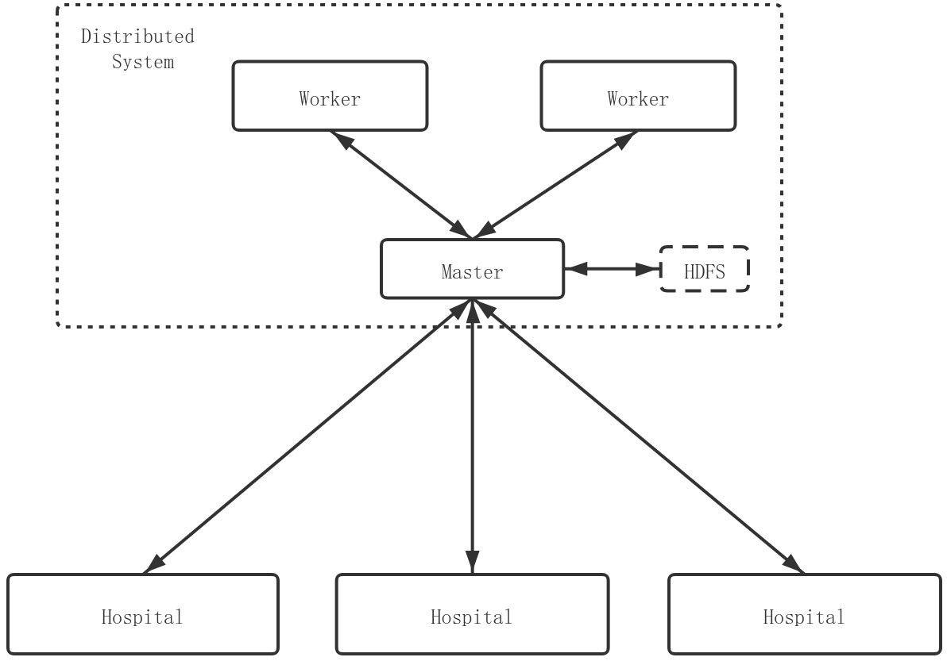
Request process
Hospital sends query to master to get prediction result.
Update process
Hospital sends update signal to master if the number of new data reaches a threshold. When the master receives the update signal, it updates the model.

Slide 6
Implementation
Major implementation ideas
  We construct our distributed system on AWS EC2 VMs.
  Data engineering for feature extraction includes but not limited to normalization, PCA, one-hot encoding, label smoothing, etc.
  We train the model with the help of Python machine learning libraries, such as PySpark and scikit-learn, etc.
  In order to deploy the distributed training, we use the library PySpark.
Results
  We deliver a distributed system with a lightweight machine learning algorithm that can assess diabetes and give advice for future care.

Slide 7
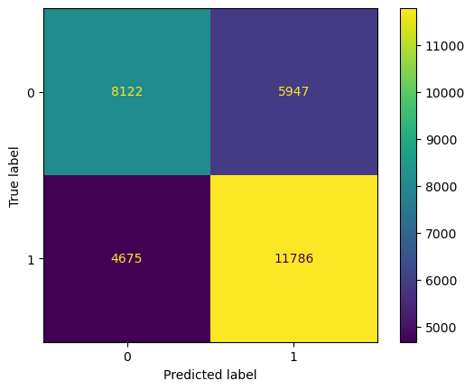
Results
Notes:
We evaluated our system in different ways, first is the confusion matrix, we can see that the TN and TP is significantly more than FN and NP

Slide 8
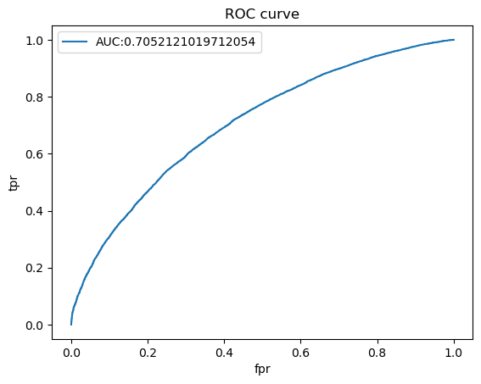
Results
Notes:
From the ROC curve, our AUC is more than 70%

Slide 9
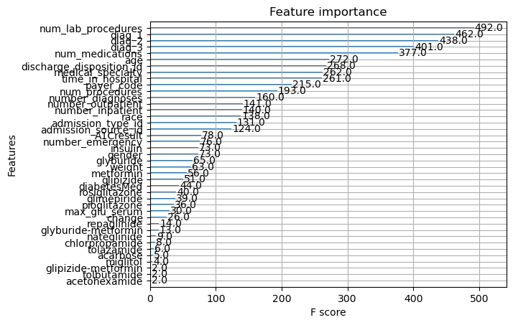
Results
Notes:
We also use PCA to see the feature importance to get some knowledge about the pre-trained model.

